Slide 1
Super store sales prediction
By-
Team Inevitables
CPL Dhanush Kumar Suresh
Shoubhik Sadhu
Naga Mallika
Sreeja
CDT Jyothsna Sai
Jayanth K

Slide 2
PROBLEM Statement
Marketing data is one of the renowned data set when it comes to research of how public relation, location and other features effect the companies’ turnover out of the given dataset. We are trying to predict the Profits that is dependent in nature. By involving necessary independent variables like location, etc., In this Project we are going to predict the nature of sales in a Super Store.
To Predict the sales of the super store from the given dataset.

Slide 3
DATA OPTIMISATION
From the given dataset we observed that few features don’t affect our independent variable.
Such features in "16Super_Stores.csv" were ROW_ID, Order ID, order date, shipping date, .... Are dropped using drop command.
REPLACING all the categorical data with equivalent numerical data.

Slide 4
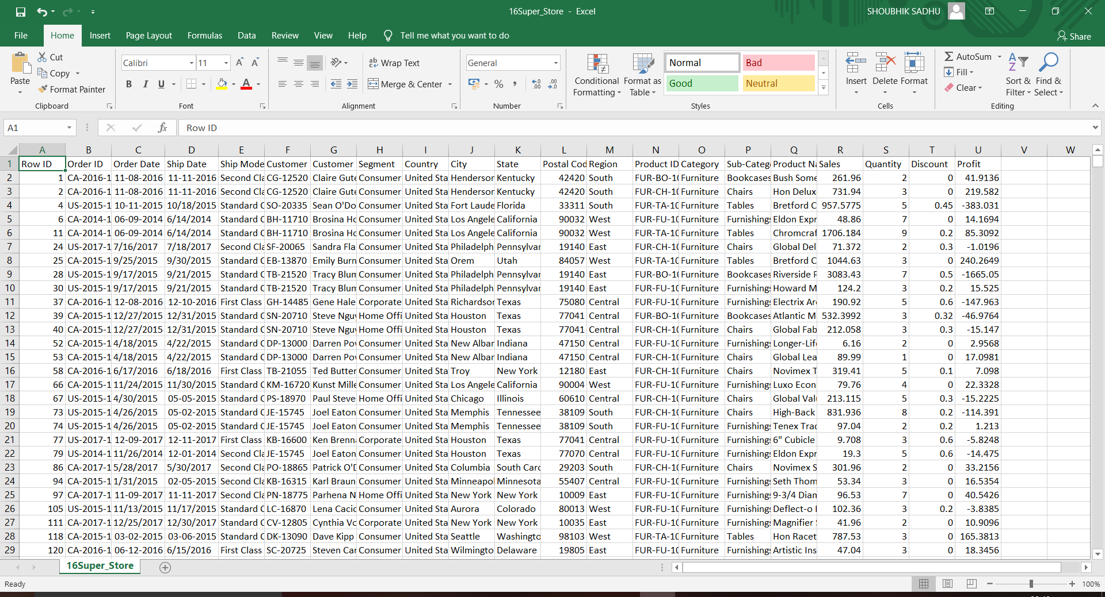
ORIGINAL DATASET

Slide 5

OPTIMIZED DATA

Slide 6
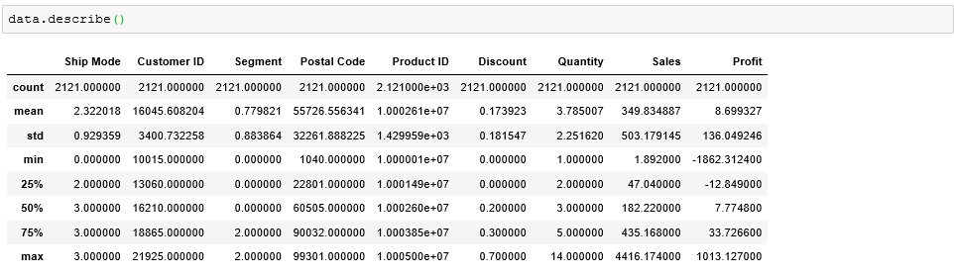
POST OPTIMIZATION describe()

Slide 7
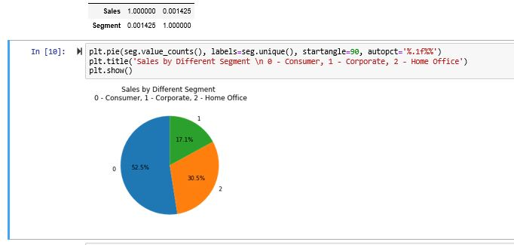
Exploratory DATA ANALYSIS
EDA for Segment and Sales
More number of sales were driven by the segments which are having the observations “Consumers” and followed by “Corporates” and finally by “Home Office” contributing 52.5%,17.1%,30.5% respectively. Even though the sales distribution curve resembles the bell curve the distribution curve of segment does not resemble bell curve even after normalization.

Slide 8
Exploratory Data Analysis
EDA for Ship Mode VS Sales
From the boxplot of the given data we can say that neither there are many outliers in the data so it decreases the Accuracy. From the Distribution graph its neither evenly distributed nor the graph resembles a bell.
EDA for Product ID and Sales
Comparing the product ID and Sales we can get to know that there are about 364 unique product Id’s and the Product ID 10001095 has the number of repetitions. It has appeared 21 times in the data set.
The mean of the profit set is 8.699327 and the profit for about 32 products is 0.00.

Slide 9
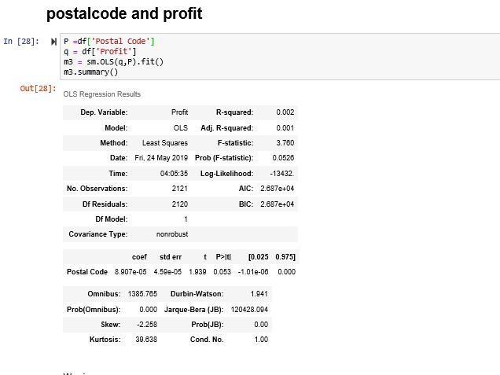
EDA for PC and profit
From the scatter plot between profit and postal code we can say that all the profit and loses counts are almost similar. From the boxplot of postal code there are no outliers.

Slide 10
EDA for Model1
Model 1 independent variables are Ship mode
Quantity, Postal Code, Discount, Product ID
Reason for choosing this model is because this model shows accuracy of 26.03% low RMSE value compared to other train_split models and high R2 values. From this scatter plot between the test value and predicted value. We can say that it is almost linear but not perfectly accurate because all the values are not uniquely mapped. By drawing the mean curve we can say that both profit and loses are almost numerically equal.
Accuracy = 26
RMSE = 117
R2 = 0.2651

Slide 11
EDA for Model 2
Model 2 independent variables are Ship mode,
Quantity, Postal Code, Discount.
Reason for choosing this model is because this model shows accuracy of 24.03% low RMSE value compared to other train_split models and high R2 values. From this scatter plot between the test value and predicted value. We can say that it is almost linear but not perfectly accurate because all the values are not uniquely mapped.
Accuracy = 0.24
RMSE = 116.652
R2 = 0.208

Slide 12
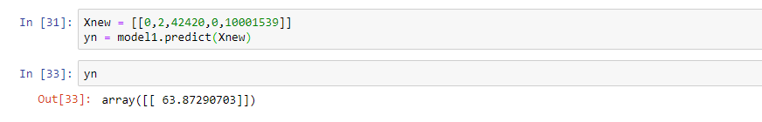
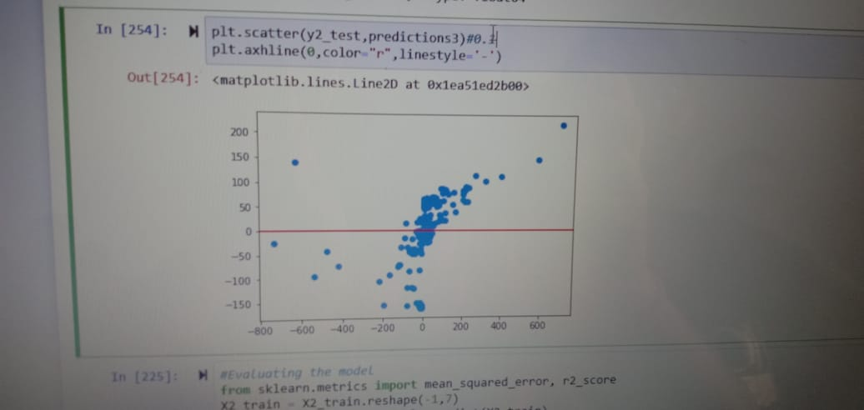
Predictions and predicted values characteristics

Slide 13
Conclusion
From the above inferences we conclude that most of the values are in negative i.e. the company’s profits are negative which means the company is running in losses due to orders from specific postal codes and type of shipping modes as well as the discounts offered on the products are high.
The super store should stop providing high discounts at specific postal codes and also in should increase the charges of the shipping modes.
If the company keeps performing like this then very soon the company would be shut down.

